Slide 1
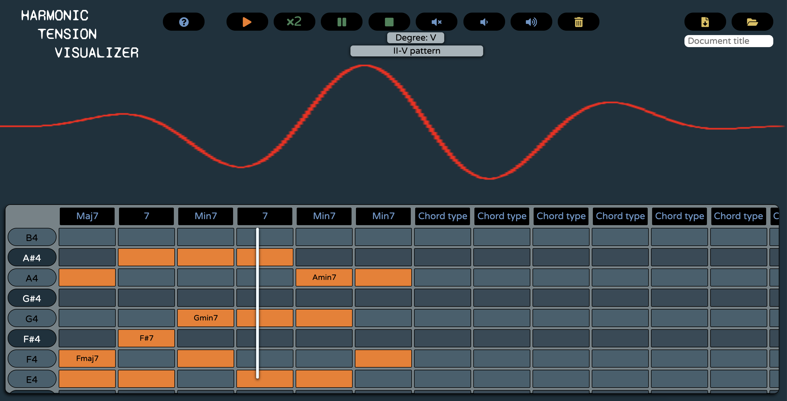
Harmonic tension visualizer
Politecnico di Milano - Advanced Coding Tool and Methodologies
Francesco Zumerle - Hakim El Achak - Elisa Castelli - Simone Lucchiari

Slide 2
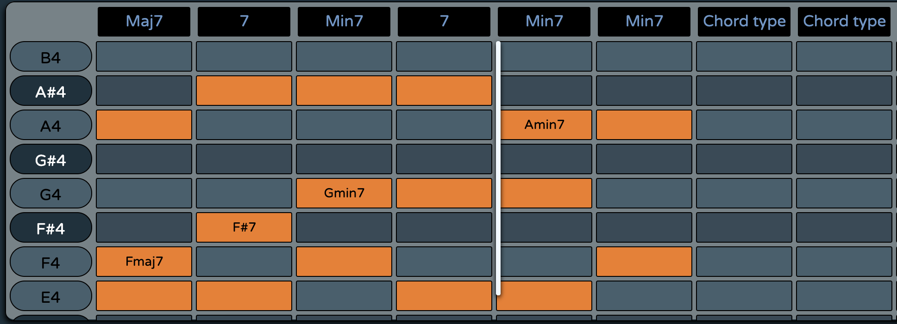
PIANO ROLL
Input chord progression
Automatic selection
File upload
Dynamic scrolling

Slide 3
TOOLBAR
Info
Progression reproduction
Volume
Reset
Download/Upload

Slide 4
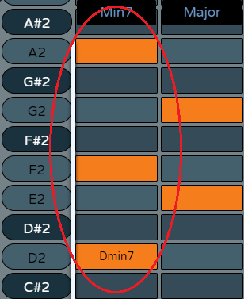
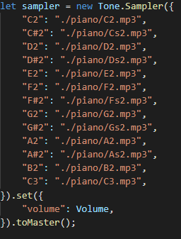
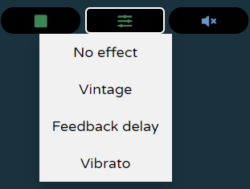
TONE.SAMPLER & TONE.JS
Multiple notes played simultaneously
“Sampler object” and binding
Output connection
TriggerAttackRelease
Effects
Vintage Distortion
Vibrato
Feedback delay

Slide 5
HARMONIC ANALYSIS

Slide 6
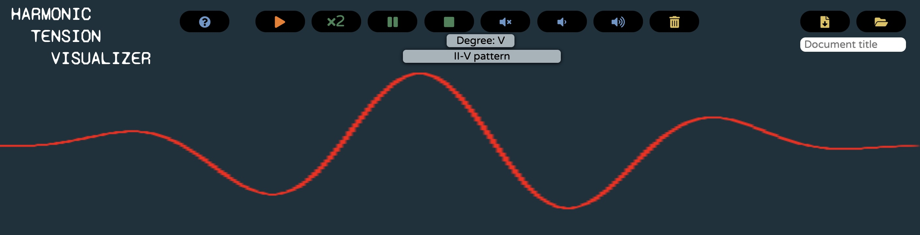
GRAPHIC REPRESENTATION
Canvas
Degree info
Pattern info
Substitution info

